Slide 1
Recursion Part 3
CS221 – 2/27/09

Slide 2
Recursion
A function calls itself directly:
Test()
{
…
Test();
…
}

Slide 3
Recursion
Or indirectly:
Test()
{
…
Test2();
…
}
Test2()
{
…
Test();
…
}

Slide 4
Recursion vs. Iteration
Is recursion usually faster?
Does recursion usually use less memory?
Why use recursion?

Slide 5
Recursion Benefits
The code can be easier to write
The code can be easier to understand
Recursion can be a powerful problem solving technique

Slide 6
Recursion Pitfalls
Infinite Recursion
No exit condition == stack overflow exception
Performance
Recursion has method call overhead

Slide 7
Rules of Recursion
Must have a base case (or exit condition)
Each recursive method call must make progress toward an eventual solution

Slide 8
Rules of Recursion
Is it broken?
void printInt( int k )
{
System.out.println( k );
printInt( k - 1 );
}

Slide 9
Rules of Recursion
How about now?
void printInt( int k )
{
if (k == 0)
{
return;
}
System.out.println( k );
printInt( k - 1 );
}

Slide 10
Rules of Recursion
Fixed?
void printInt( int k )
{
if (k <= 0)
{
return;
}
System.out.println( k );
printInt( k - 1 );
}

Slide 11
Recursive Thinking
When a recursive call is made, the method clones itself
Code
Local variables with initial values
Parameters
Leaves behind a marker of where to return
When the call returns, the clone is destroyed and you return to the previous marker

Slide 12
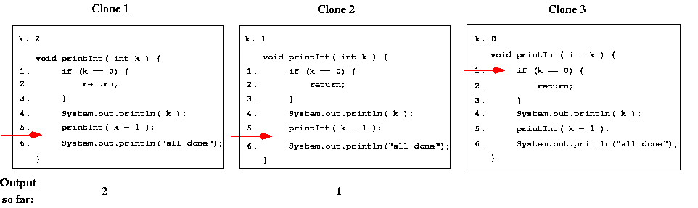
PrintInt(2)

Slide 13
How Method Calls Work
Java maintains a stack of activation records
Method parameters
Local variables
Return address
When a method is called, this activation records is pushed on the stack
When a method returns it is popped from the stack and execution returns to the return address

Slide 14
Example Method (non-recursive)
void printChar( char c ) {
2. System.out.print(c);
3. }
void main (...)
{
6. char ch = 'a’;
7. printChar(ch);
ch = 'b’;
printChar(ch);
10. }

Slide 15
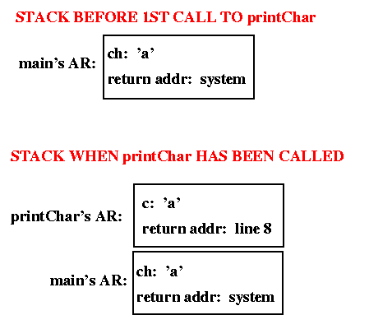
Call Stack

Slide 16
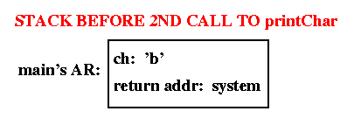
Call Stack

Slide 17
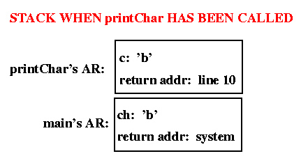
Call Stack

Slide 18
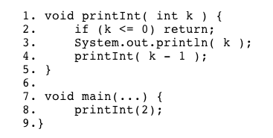
Example Method (recursive)

Slide 19
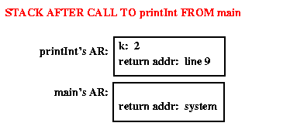
Call Stack

Slide 20
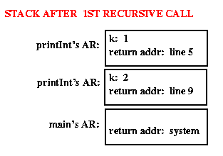
Call Stack

Slide 21
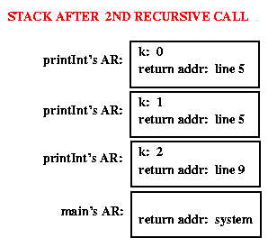
Call Stack

Slide 22
Question
What is printed?
void printInt( int k )
{
if (k <= 0)
{
return;
}
System.out.println( k );
printInt( k - 1 );
}

Slide 23
Question
Now what is printed?
void printInt( int k )
{
if (k <= 0)
{
return;
}
printInt( k - 1 );
System.out.println( k );
}

Slide 24
Question
What is printed?
Void printTwoInts(int k)
{
if (k == 0)
{
return;
}
System.out.println(“Before recursion: “ + k);
printTwoInts(k-1);
System.out.println(“After recursion: “ + k);
}

Slide 25
Result
Before recursion: 3
Before recursion: 2
Before recursion: 1
After recursion: 1
After recursion: 2
After recursion: 3

Slide 26
Fibonacci Revisited
Fibonacci can be defined as follows:
Fibonacci of 1 or 2 = 1
Fibonacci of N (for N>2) = fibonacci of (N-1) + fibonacci of (N-2)
Iterative vs. Recursive…

Slide 27
Iterative Fibonacci
Int fib (int n)
{
int k1, k2, k3;
k1 = k2 = k3 = 1;
for (int j=3; j<=n; j++)
{
k3 = k1 + k2;
k1 = k2;
k2 = k3;
}
return k3;
}

Slide 28
Recursive Fibonacci
int fib (int n)
{
if ((n==1) || (n==2))
{
return 1;
}
else
{
return (fib(n-1) + fib(n-2));
}

Slide 29
Fibonacci Compared
The recursive version is:
Shorter
Clearer
Much slower

Slide 30
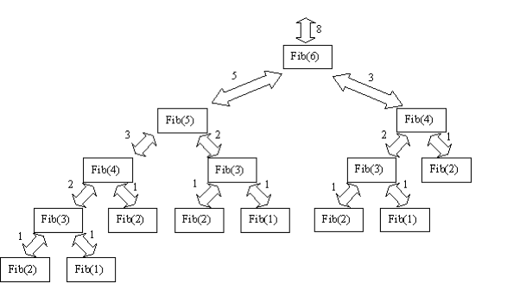
Call Stack

Slide 31
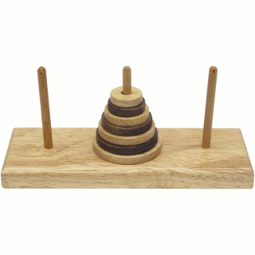
Towers of Hanoi

Slide 32
Towers of Hanoi
Especially impressive display of recursion!
If you understand the towers, you’ll understand recursion
Given three posts (towers) and n disks of decreasing sizes, move the disks from one post to another one at a time without putting a larger disk on a smaller one.

Slide 33
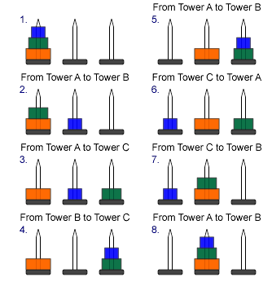
Solution
Notes:
http://www.cosc.canterbury.ac.nz/mukundan/dsal/ToHdb.html

Slide 34
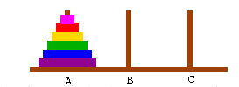
How do we get there?
We want to move all disks from peg A to B

Slide 35

Step 1
Move all but largest from A to C

Slide 36

Step 2
Move largest from A to B

Slide 37

Step 3
Move the rest from C to B

Slide 38
PseudoCode
Tower(disk, start, finish, spare)
If disk == 0 then
Move disk from start to finish
Else
Tower(disk-1, start, spare, finish) //Step 1
Move disk from start to finish //Step 2
Tower(disk – 1, spare, finish, start) //Step 3
Notes:
http://www.cs.cmu.edu/~cburch/survey/recurse/hanoiex.html

Slide 39
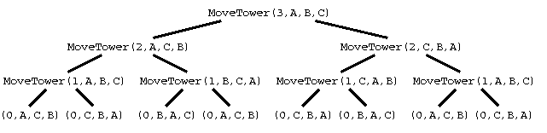
Call Trace

Slide 40
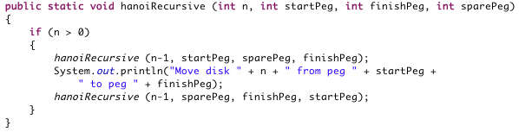
Recursive Solution

Slide 41
Question
What is the time complexity?
What is the space complexity?

Slide 42

The Tower Legend
Legend has it that when the 64 disk problem is solved the world will end. How long will that take?
2^64 moves = 1.845x10^45
One move per second
600 billion years….

Slide 43
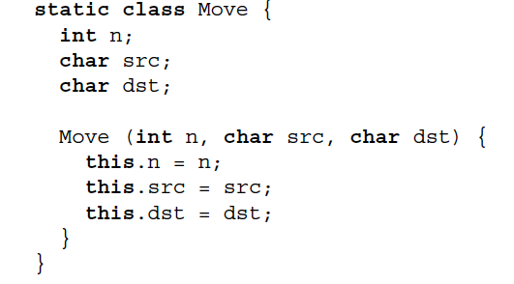
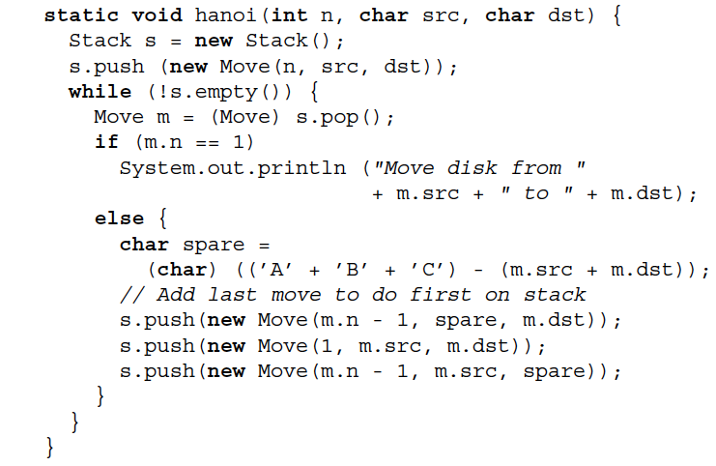
Iterative Solution

Slide 44
Key points
Use recursion to improve code clarity
Make sure the performance trade-off is worth it
Every recursive method must have a base case to avoid infinite recursion
Every recursive method call must make progress toward an eventual solution
Sometime a recursive method will do more work as the call stack unwinds

